Slide 1




OMICRON
By Simeon Vangelov

Slide 2


What is even my idea?
Its just Reddit...
Its a website designed to browse and interact with a specific community

Slide 3




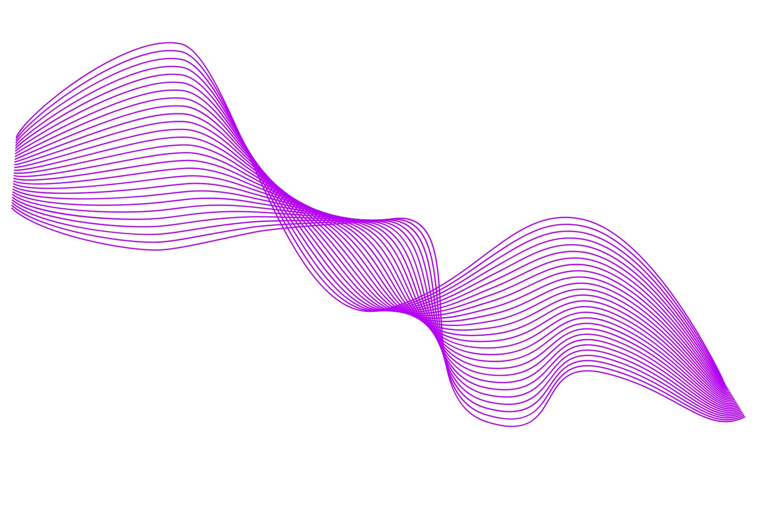
What is the stack?
MySQL
Actix
Yew
A powerful data storage system
A multithreaded rust based server providing low level control and blazingly fast results
A multithreaded rust based Frontend framework designed for maximal speed with WASM and low level control

Slide 4
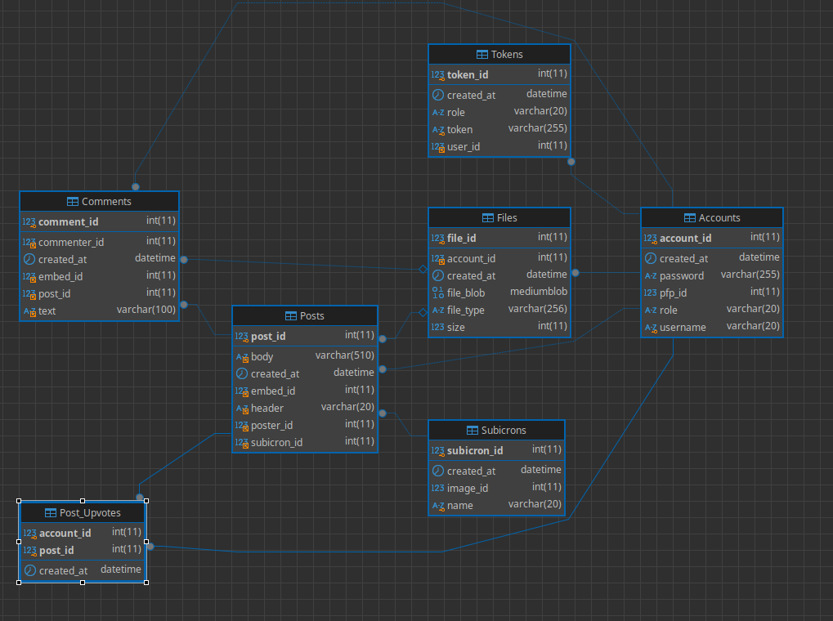



Database Design
Each Subicron (my verison of a subreddit) has post which have comments
comments and posts are connected with users

Slide 5

LETS EXPLORE!!!

Slide 6
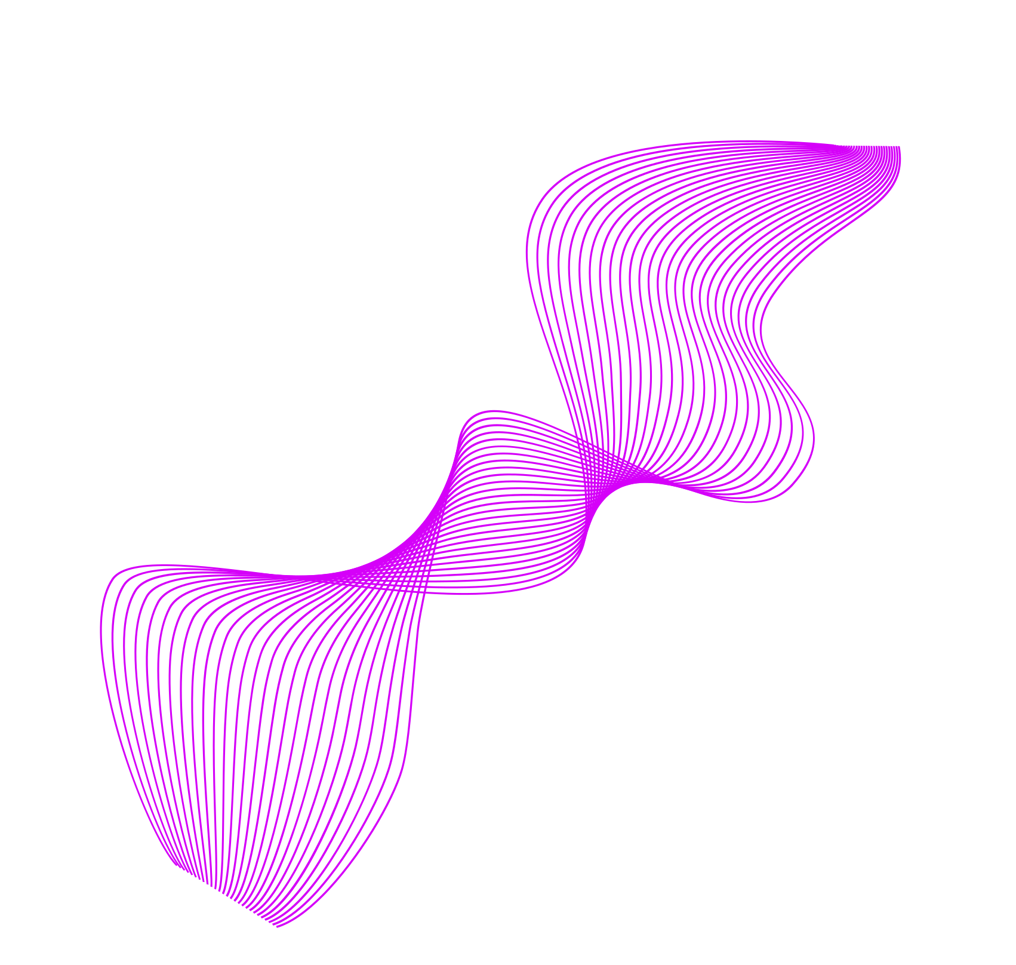
THANK YOU FOR YOUR TIME!!!

